Slide 1
VNA Software Applications
Nick Lalic
VNA Software Developer
Rohde & Schwarz North America
March 7-11th, 2016

Slide 2
PA Compression Test

Slide 3
PA Compression Test
Case study: MACOM Boston, Massachusetts USA
Setup:
Pulsed RF power
Driver amplifier
Calibration
One Path, Two port
Question: How to power cal?
VNA
Port1
Port2
Driver
PA S(f, P_{in})
Input Power (P_{in})
Output Power (P_{out})
Calibration Planes
Power Cal. Plane

Slide 4
PA Compression Test
Option 1 – Power cal
Standard Power cal of source, receiver on Port 1
Calculate compression from S₂₁(f, P_{in})
Problems:
No “2D” source power cal (vs power, frequency)
Driver amplifier will drift
VNA
Port1
Port2
Driver
S(f, P_{in})
Input Power (P_{in})
Output Power (P_{out})
Calibration Planes
Power Cal. Plane

Slide 5
PA Compression Test
Option 2: ALC
Standard Power cal of source, receiver on Port 1
Enable ALC
Calculate compression from S₂₁(f, P_{in})
Problems:
ALC is slow
ALC (often) too slow for pulsed RF
VNA
Port1
Port2
Driver
S(f, P_{in})
Input Power (P_{in})
Output Power (P_{out})
Calibration Planes
Power Cal, ALC Plane

Slide 6
PA Compression Test
Option 3: Use measured power
Standard Power cal of source, receiver on Port 1
Measure source power (a₁) along with S-Parameters
Calculate compression from S₂₁(f, a₁)
VNA
Port1
Port2
Driver
S(f, P_{in})
Input Power (P_{in})
Output Power (P_{out})
Calibration Planes
Power Cal. Plane

Slide 7
PA Compression Test
Option 3: Use measured power
Options 1, 2 illustrated
Measure S₂₁, plot vs theoretical power
Use power cal, ALC to force actual power to theoretical
Gain
Pin

Slide 8
PA Compression Test
Option 3: Use measured power
Option 3 illustrated
Meassure [S] vs measured power
Plot vs measured power
Gain
Pin

Slide 9
PA Compression Test
MACOM Boston, Massachusettes USA
Port1
Port2
S1
a1
b1
S2
a2
b2
Driver
PA S(f, P_{in})
Input Power (P_{in})
Output Power (P_{out})
Calibration Planes
Power Cal. Plane

Slide 10
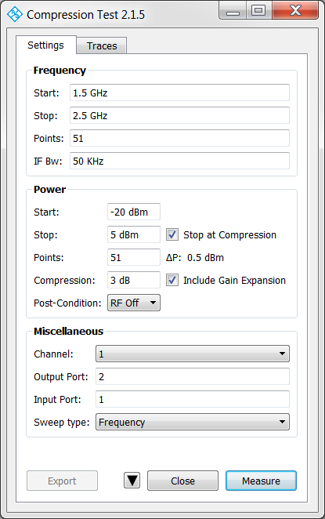
PA Compression Test
Settings
Setup
Reference Channel

Slide 11
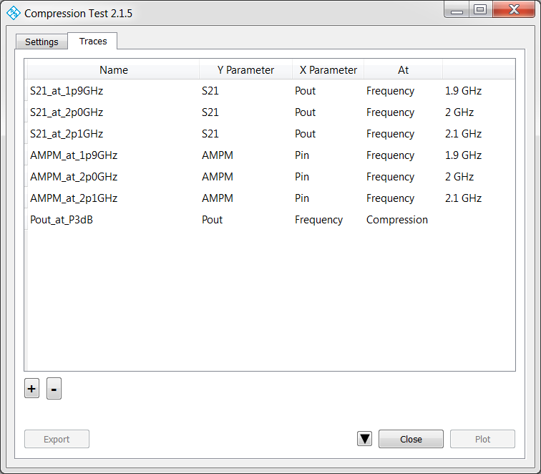
PA Compression Test
Traces

Slide 12
PA Compression Test
Trace Options
Y:
S11, S21, S12, S22
AM-PM Conversion
Pin
Pout
X:
Frequency
Pin
Pout
At:
Compression
Max. Gain
Frequency value
Power value

Slide 13
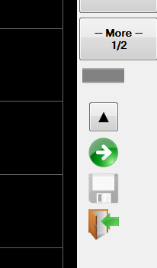
PA Compression Test
Mini GUI
Run (Measure, Update Traces)
Export
Exit

Slide 14
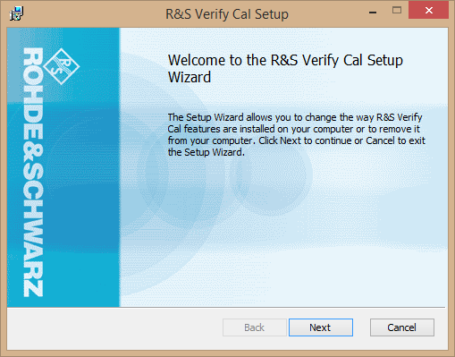
Applications
Applications work with all VNAs
For each application:
Application Card (PDF)
Installer (MSI)

Slide 15
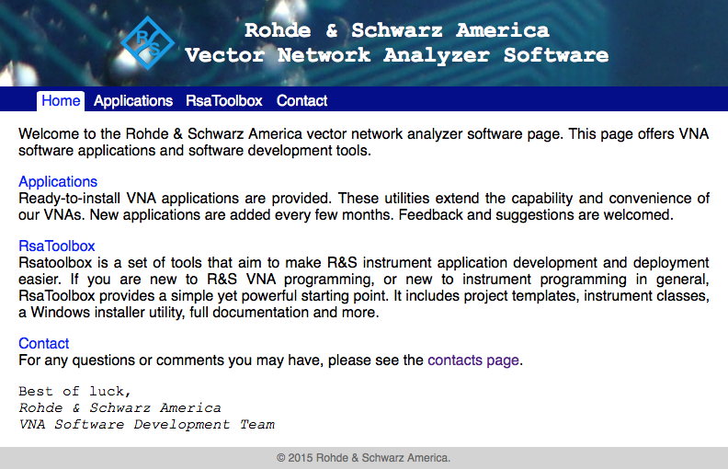
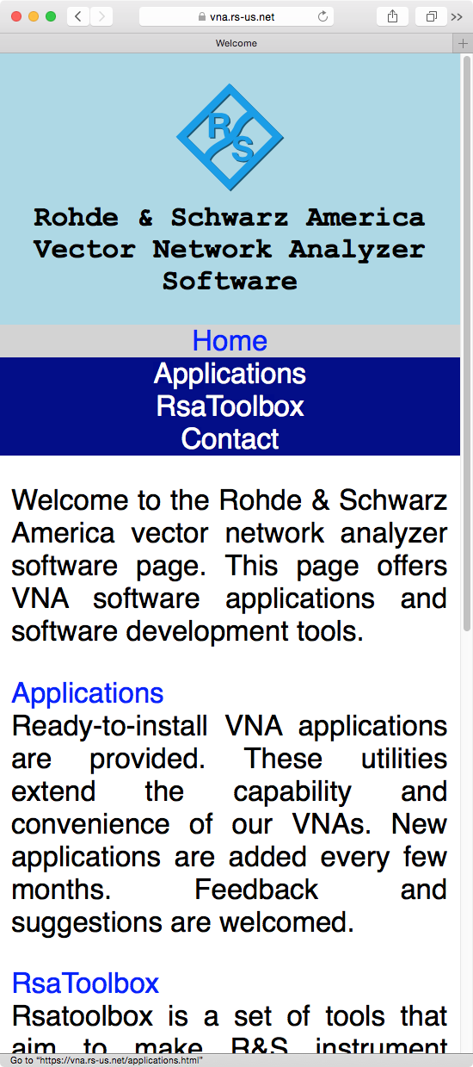
VNA Software Webpage
http://vna.rs-us.net
Mobile

Slide 16
Contact
Please contact me with feedback or requests
Nick Lalic VNA Software Developer
Cupertino, CA
+1 (424) 200-2846 nick.lalic@rsa.rohde-schwarz.com
http://vna.rs-us.net

